Slide 1
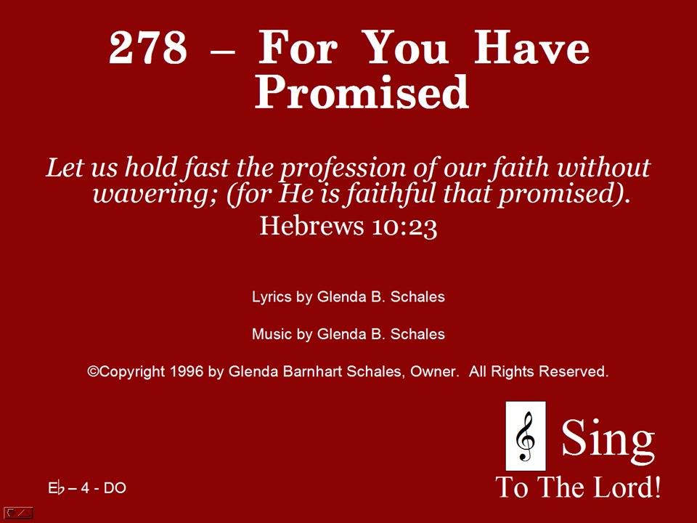
278 - For You Have Promised - Title

Slide 2
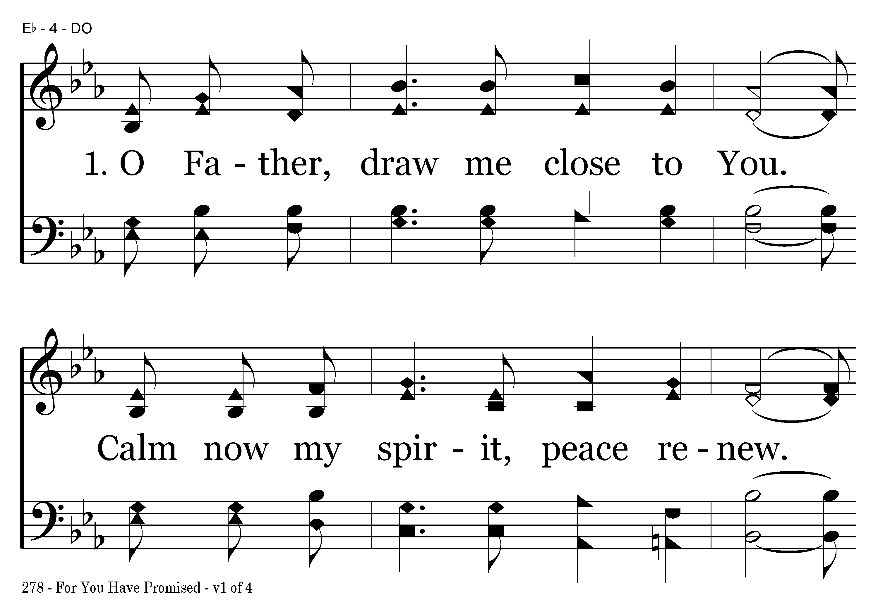
278 - For You Have Promised - 1.1

Slide 3
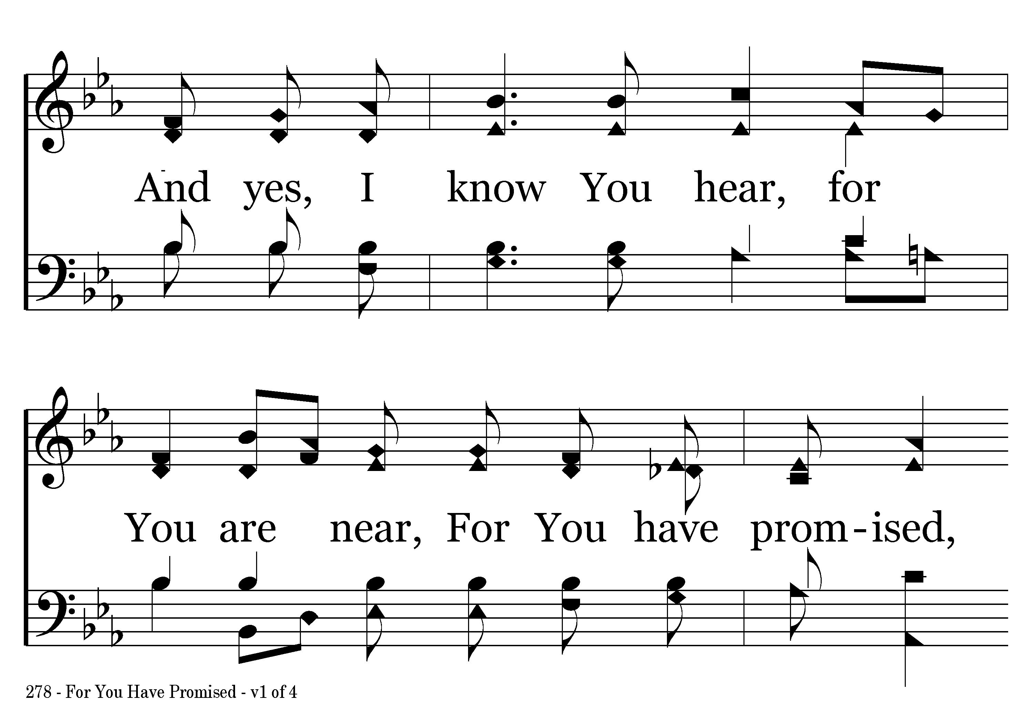
278 - For You Have Promised - 1.2

Slide 4
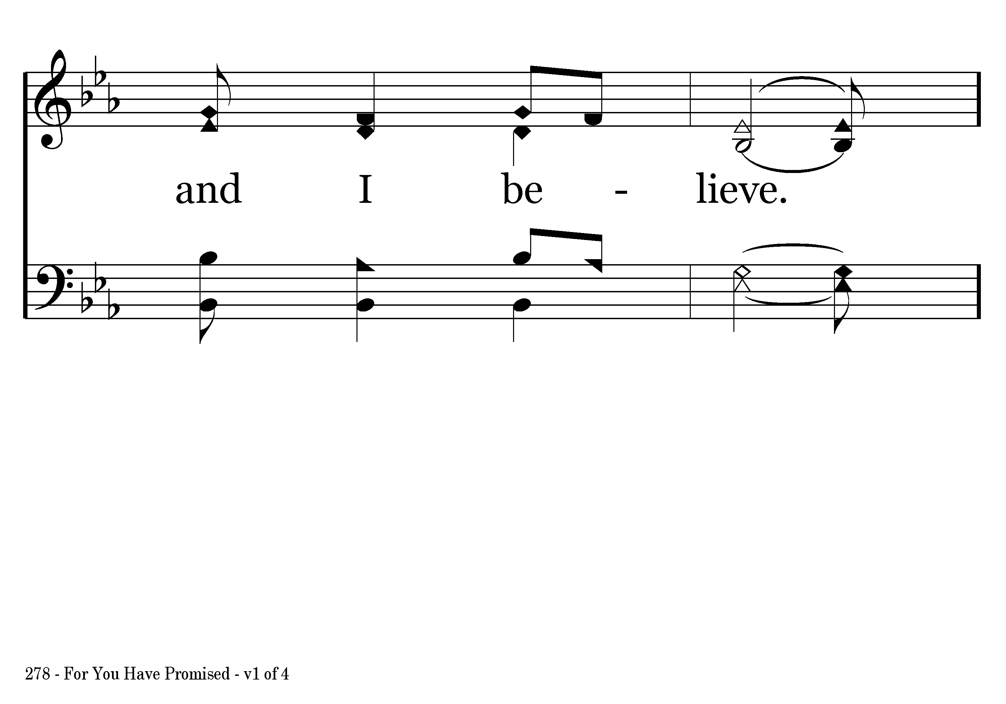
278 - For You Have Promised - 1.3

Slide 5
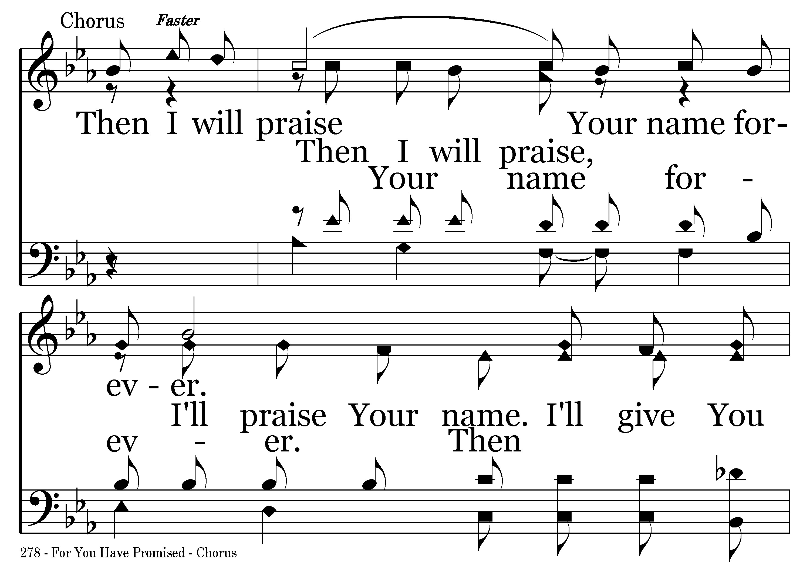
278 - For You Have Promised - C.1

Slide 6
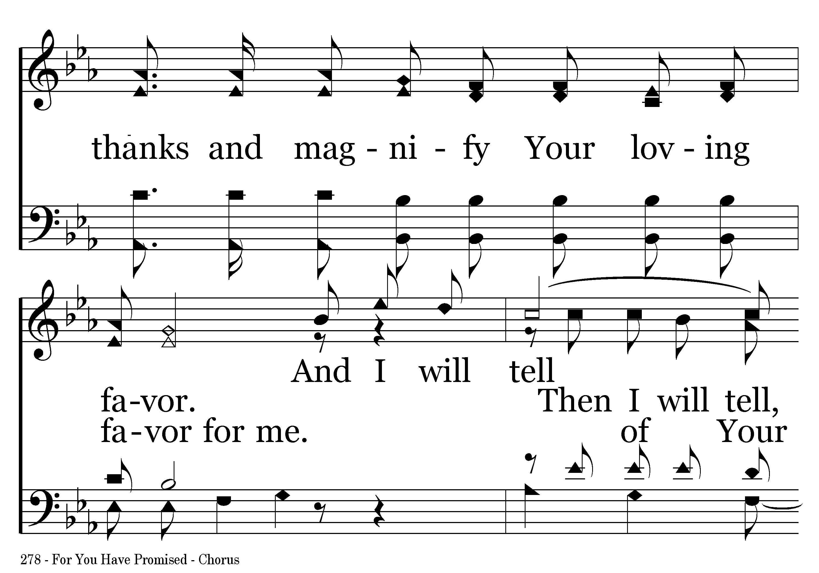
278 - For You Have Promised - C.2

Slide 7
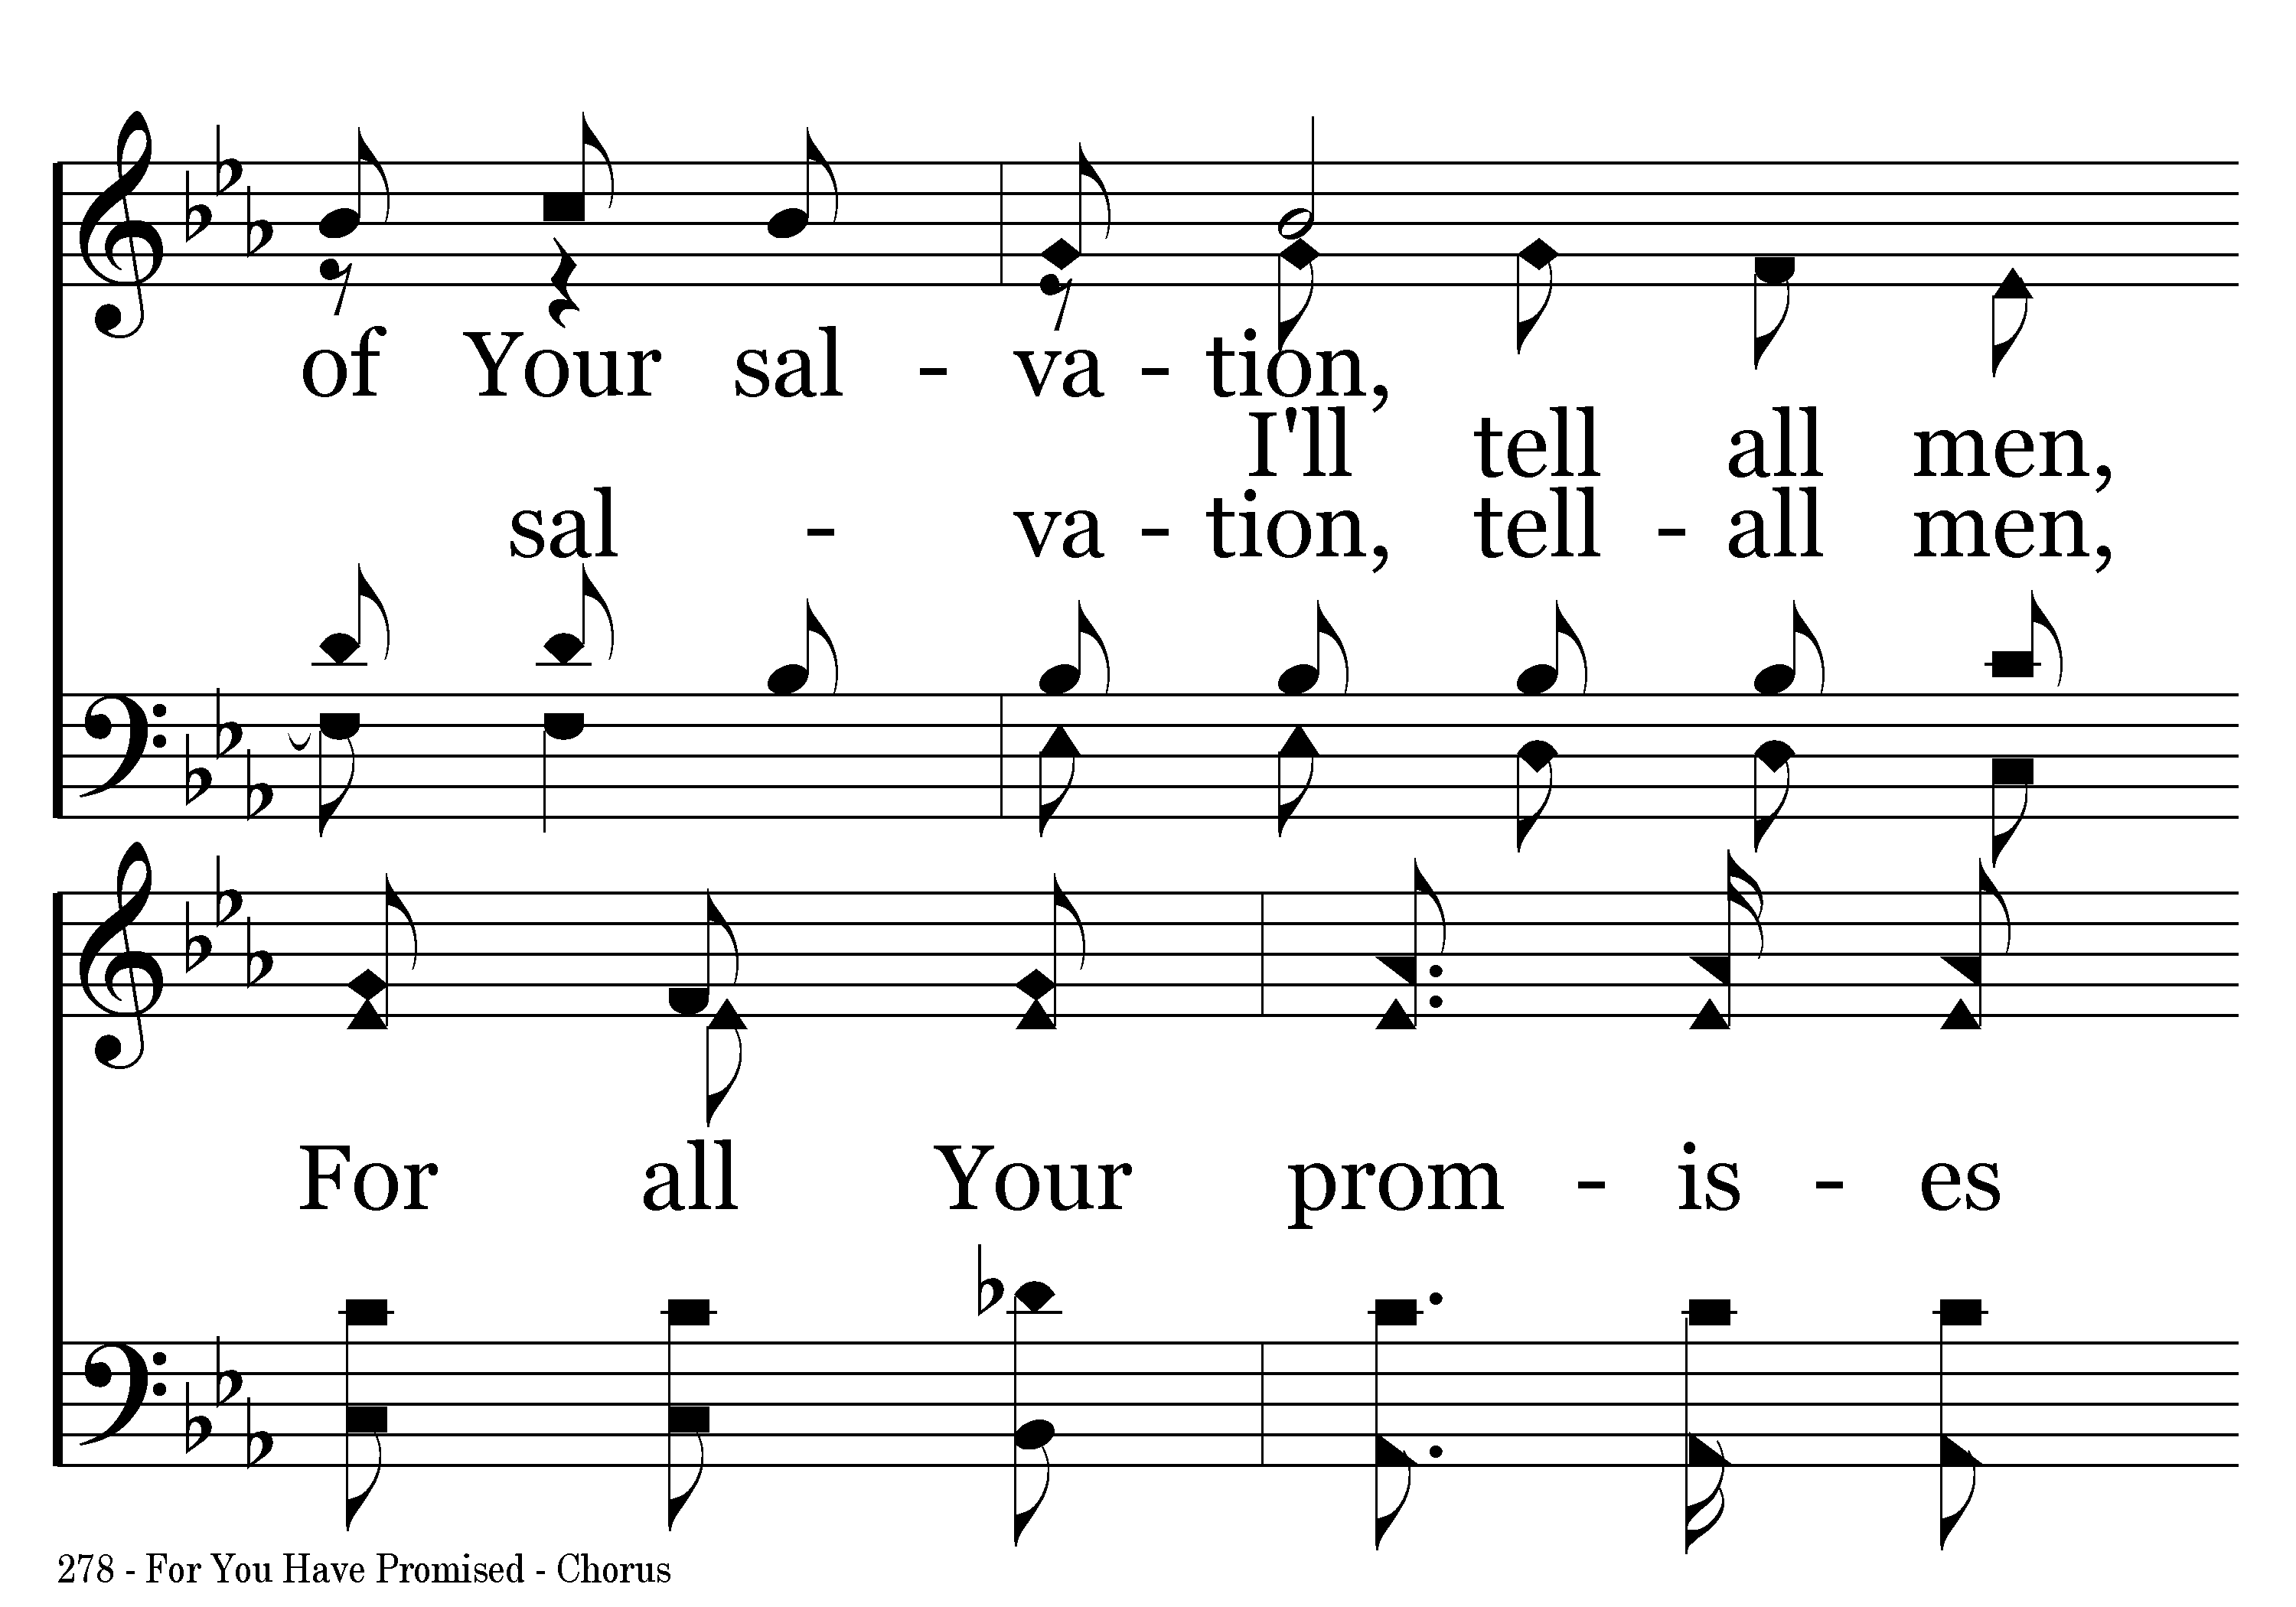
278 - For You Have Promised - C.3

Slide 8
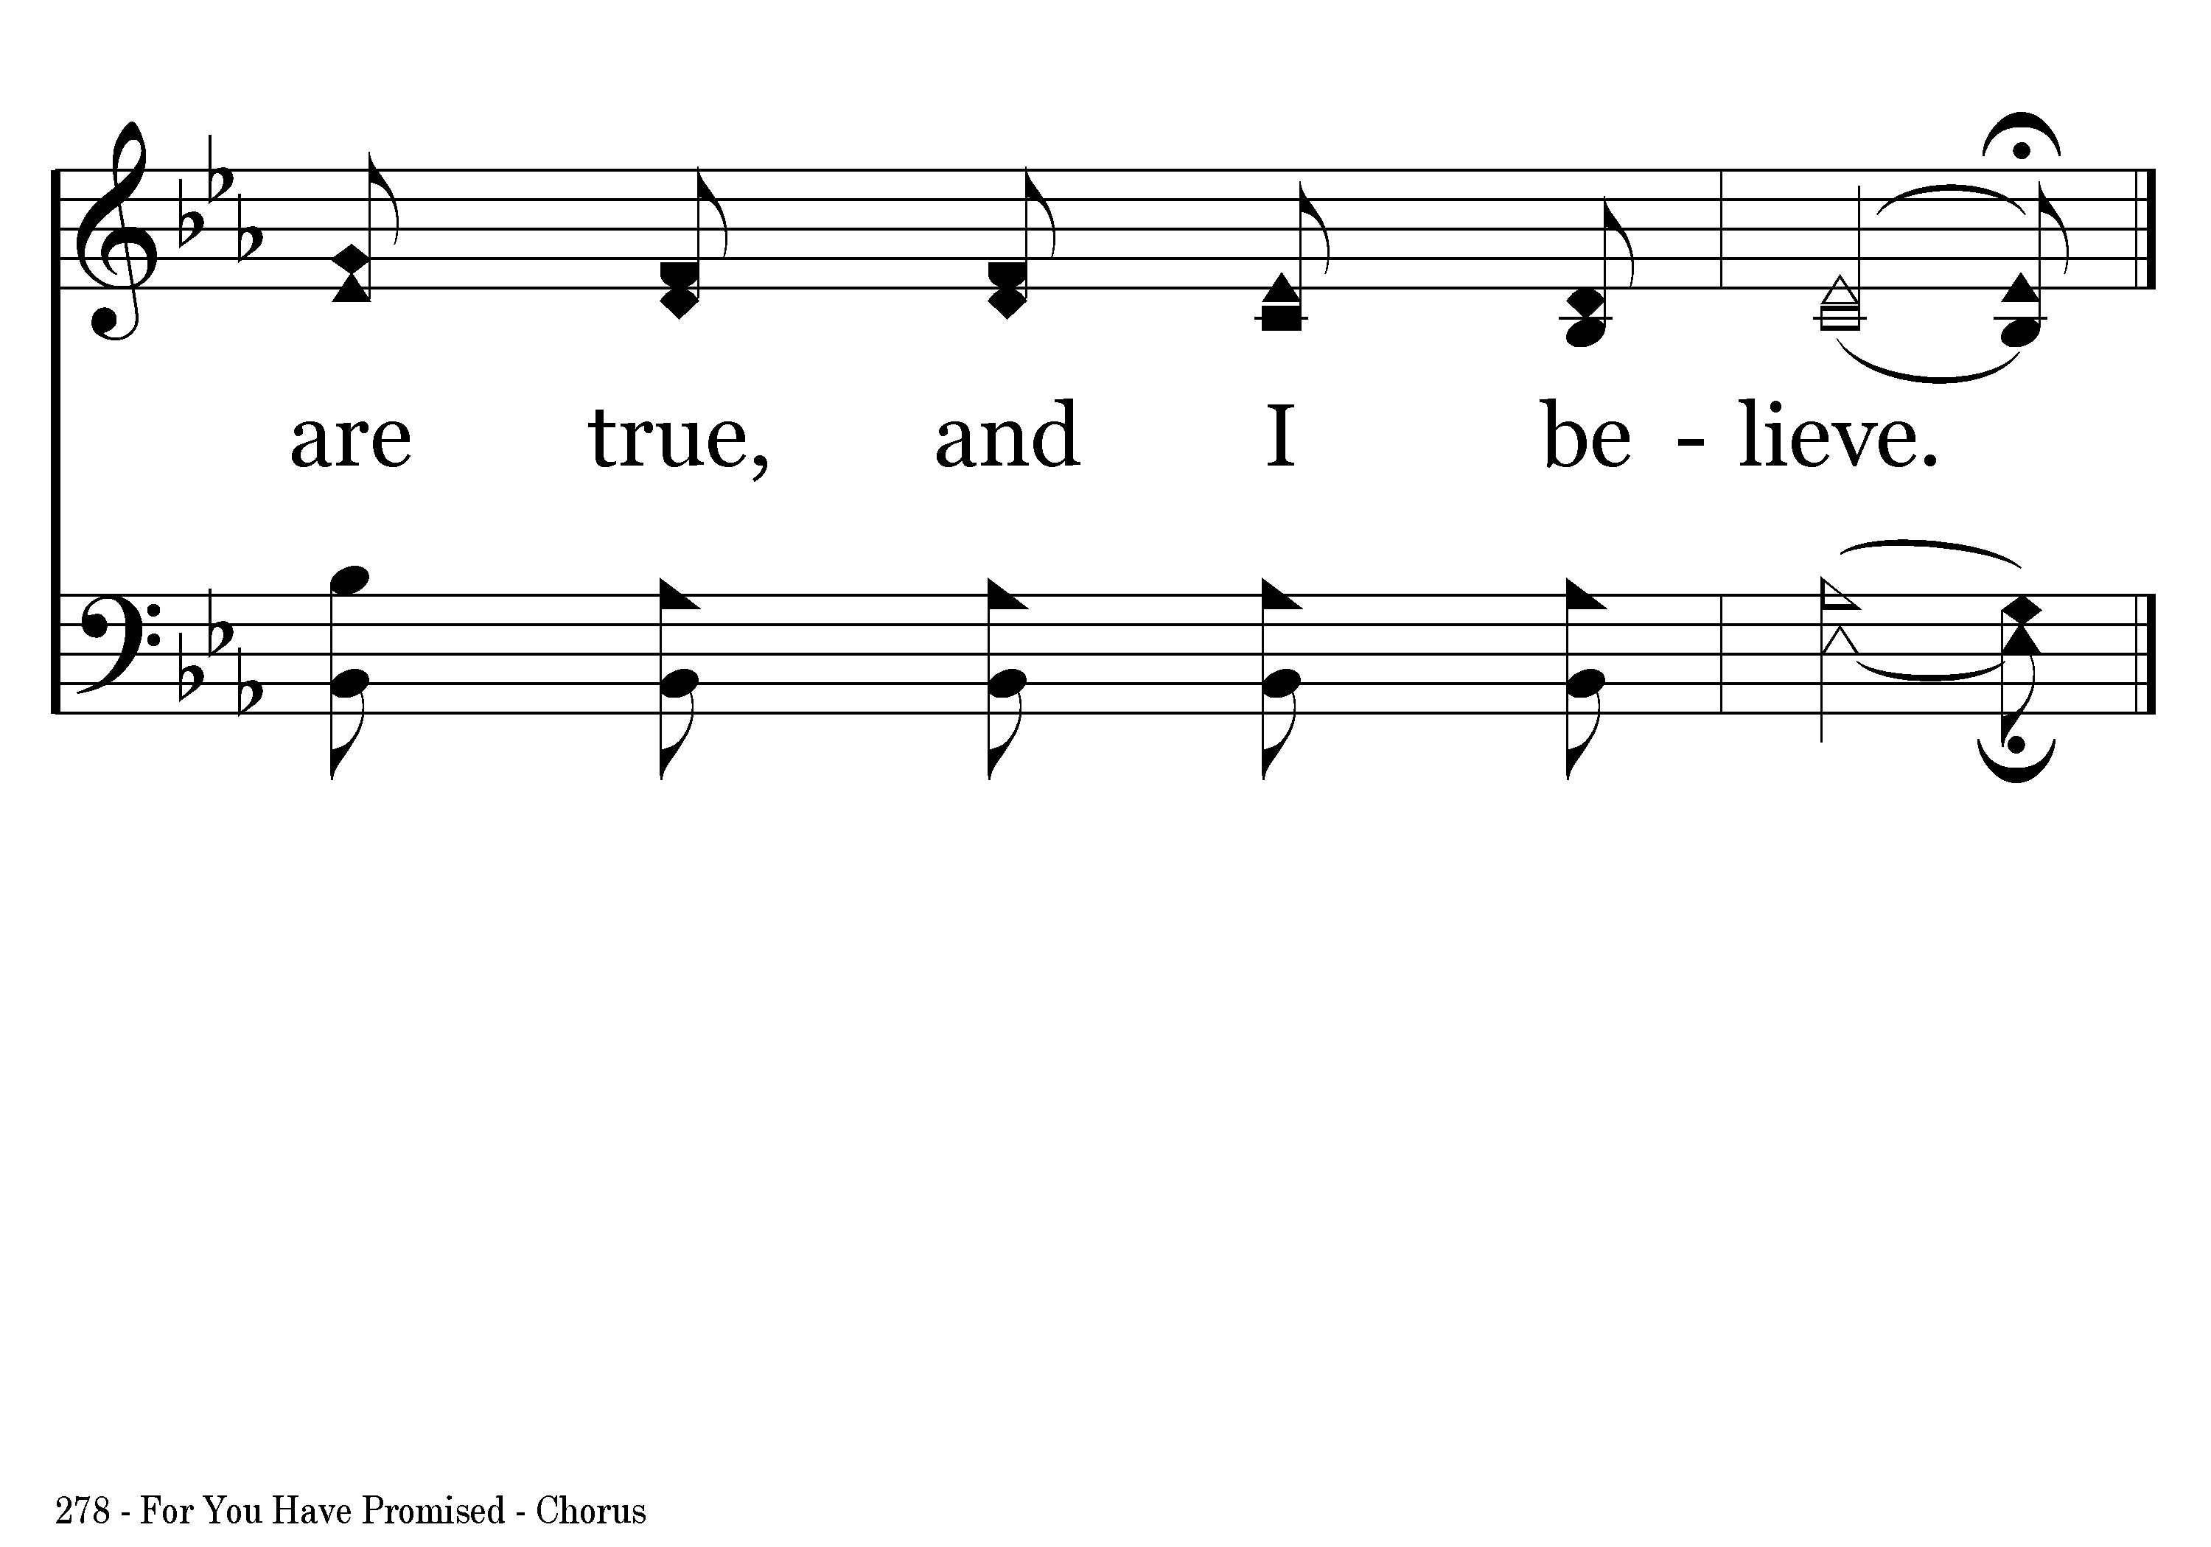
278 - For You Have Promised - C.4
End of Verse 1

Slide 9
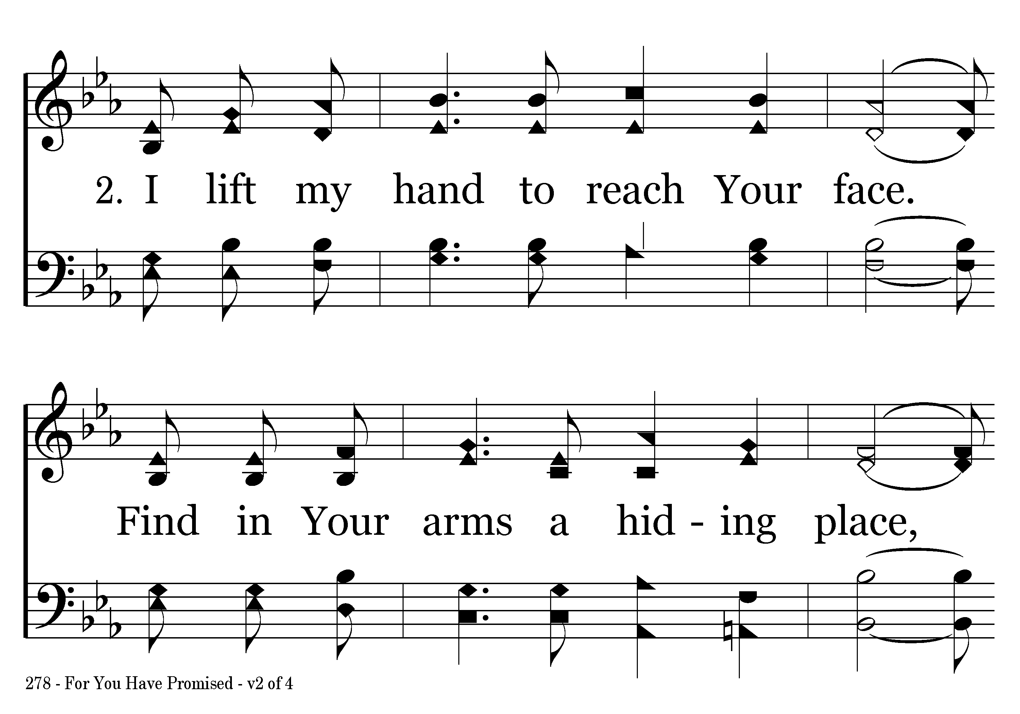
278 - For You Have Promised - 2.1

Slide 10
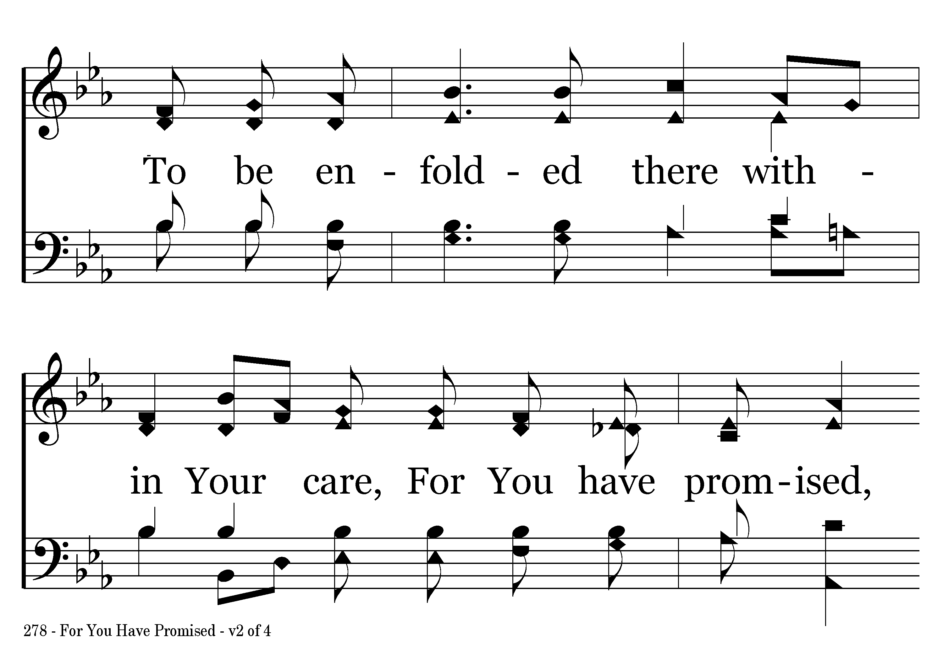
278 - For You Have Promised - 2.2

Slide 11
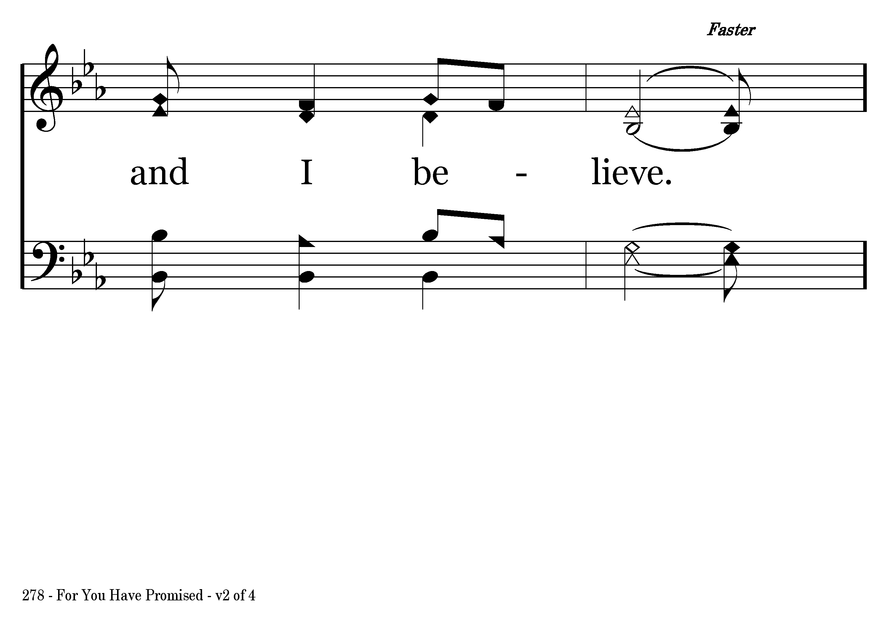
278 - For You Have Promised - 2.3

Slide 12
278 - For You Have Promised - C.1

Slide 13
278 - For You Have Promised - C.2

Slide 14
278 - For You Have Promised - C.3

Slide 15
278 - For You Have Promised - C.4
End of Verse 2

Slide 16
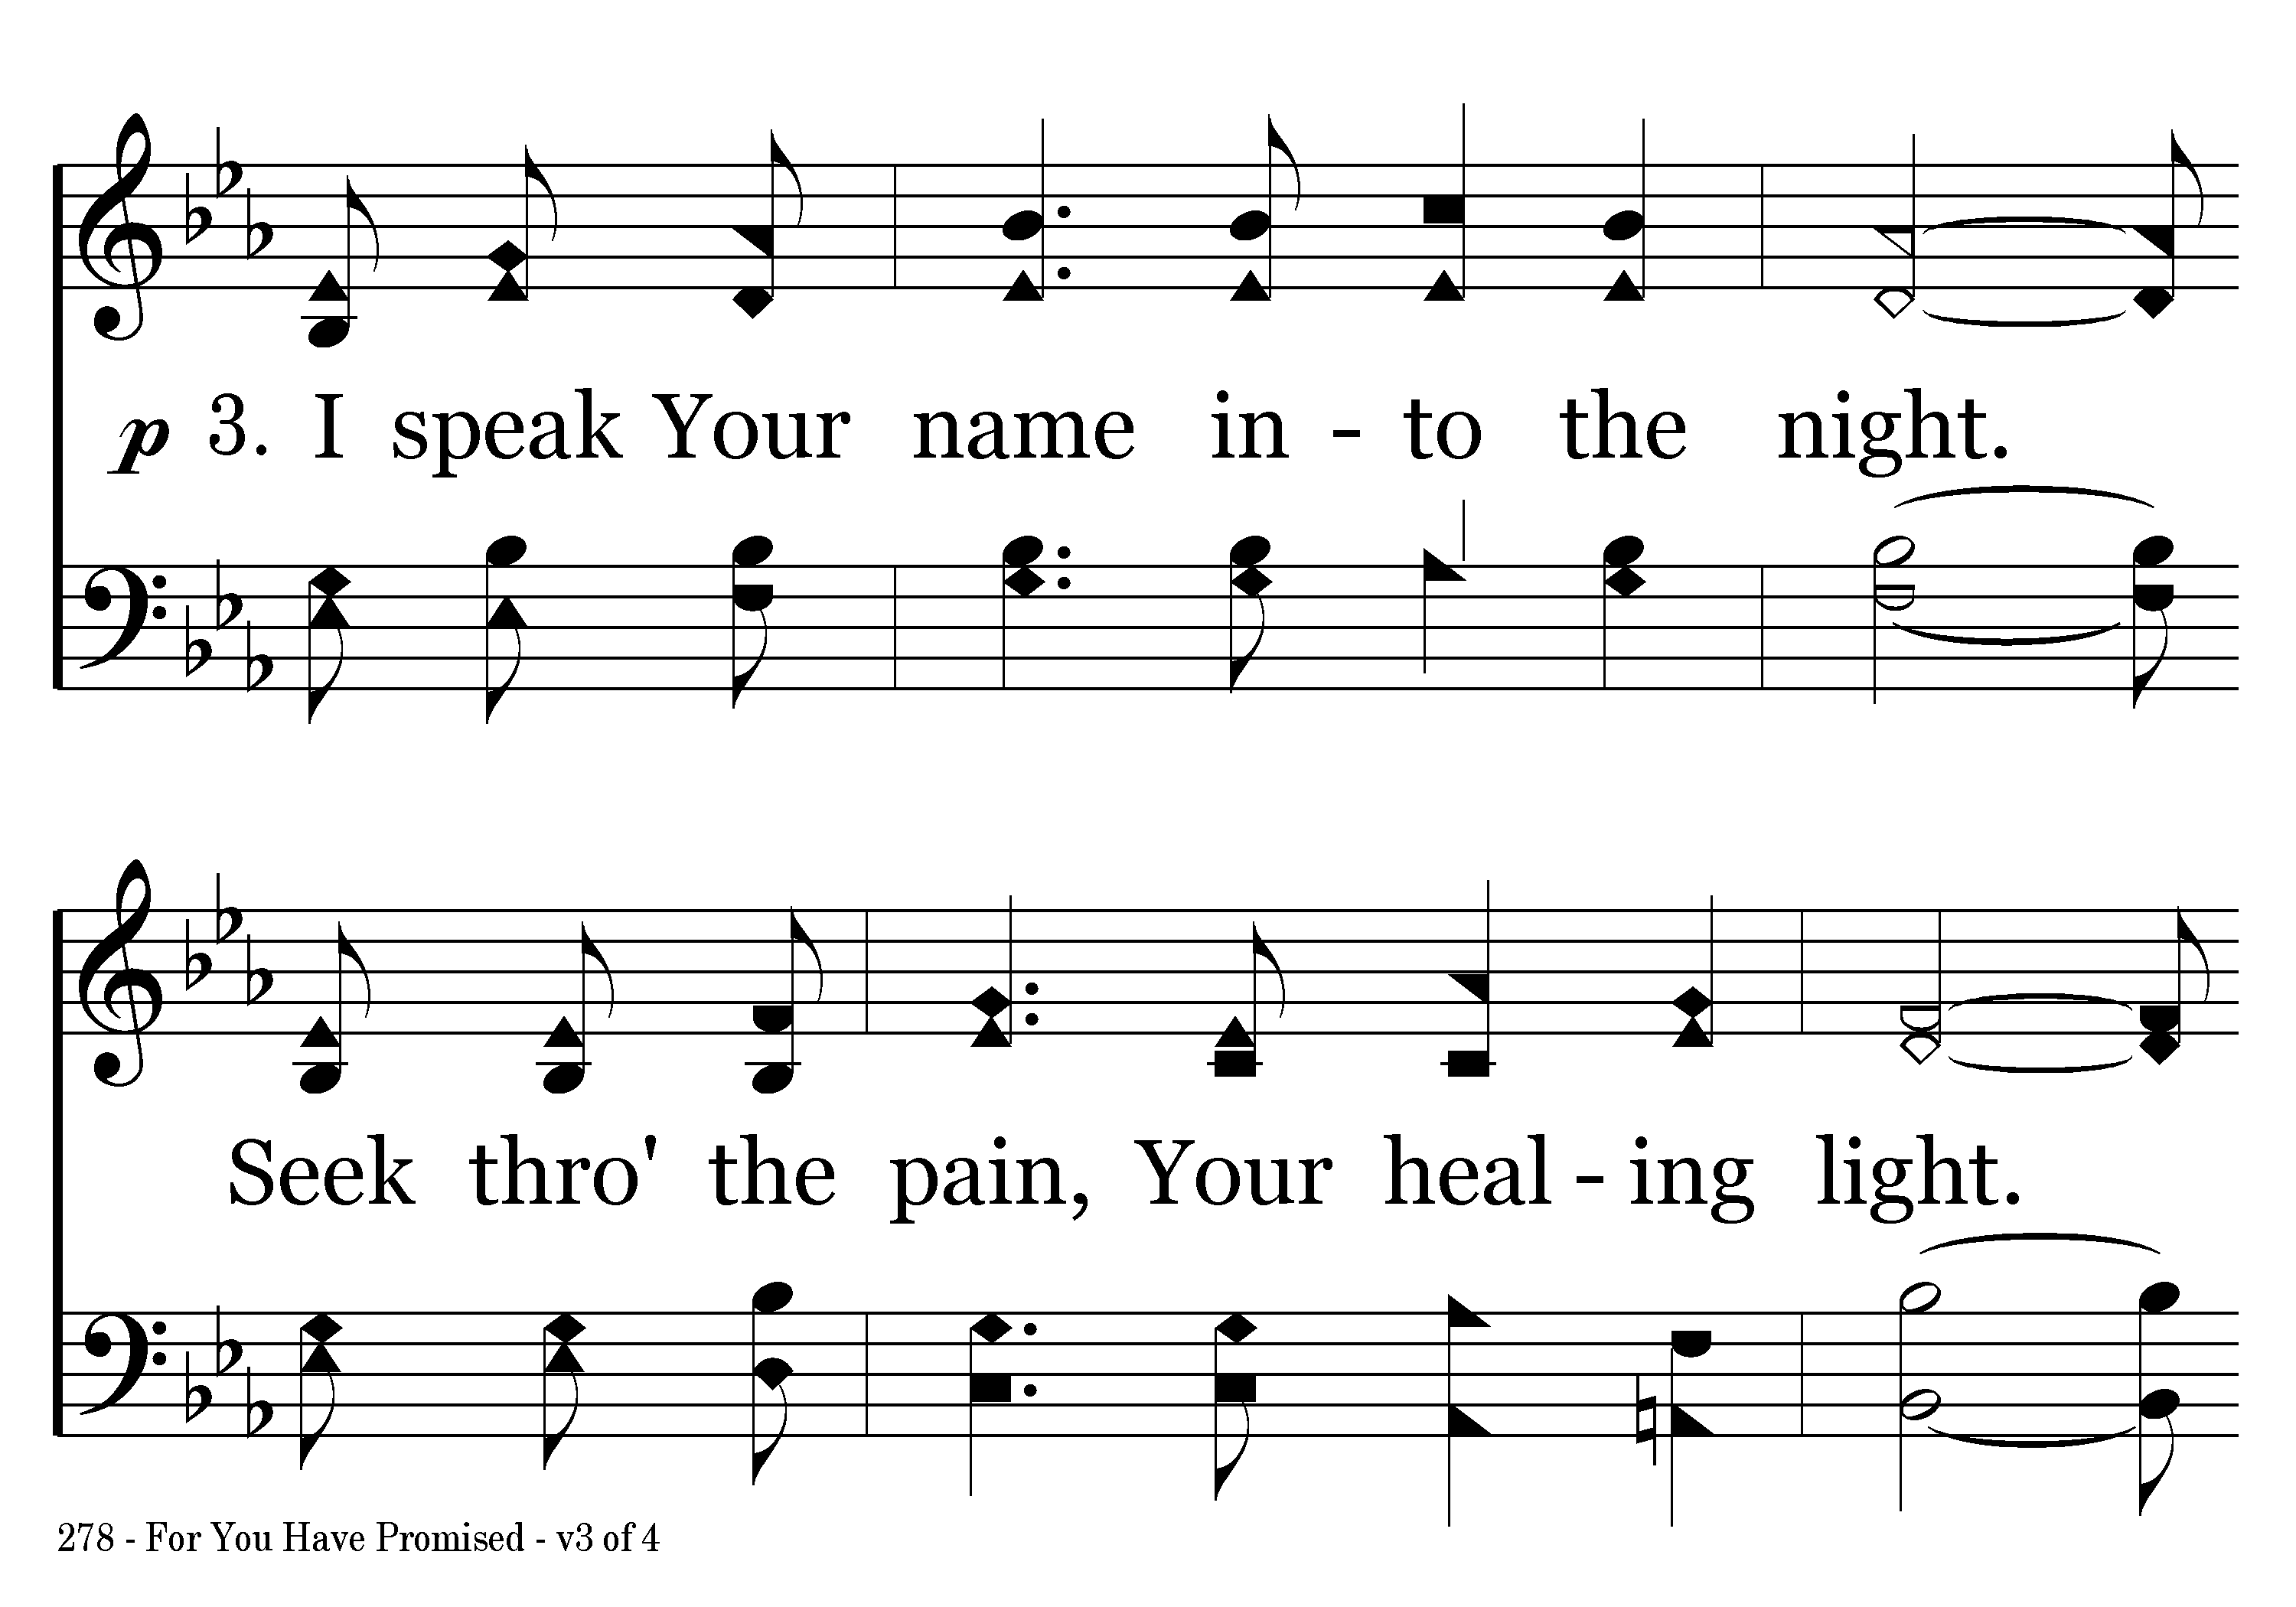
278 - For You Have Promised - 3.1

Slide 17
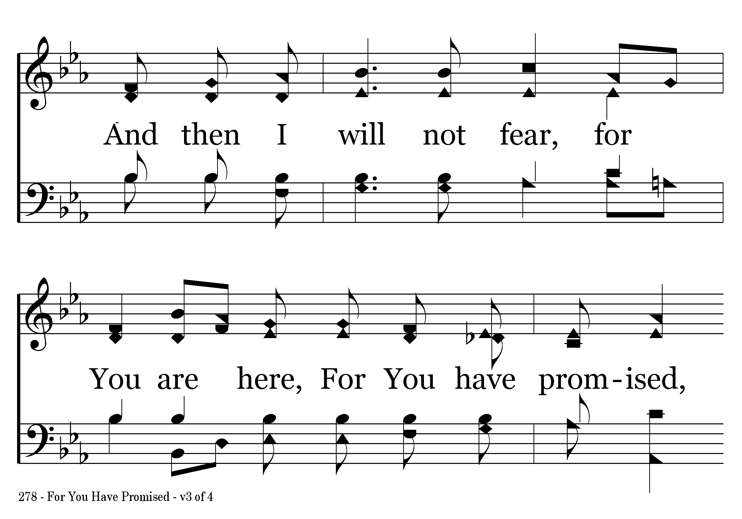
278 - For You Have Promised - 3.2

Slide 18
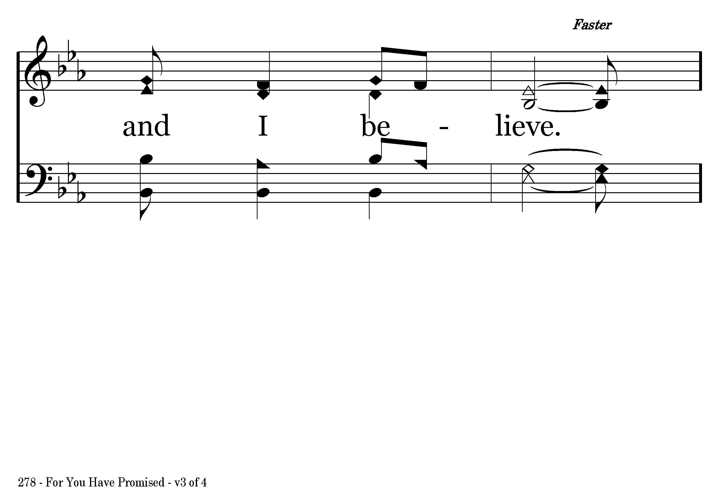
278 - For You Have Promised - 3.3

Slide 19
278 - For You Have Promised - C.1

Slide 20
278 - For You Have Promised - C.2

Slide 21
278 - For You Have Promised - C.3

Slide 22
278 - For You Have Promised - C.4
End of Verse 3

Slide 23
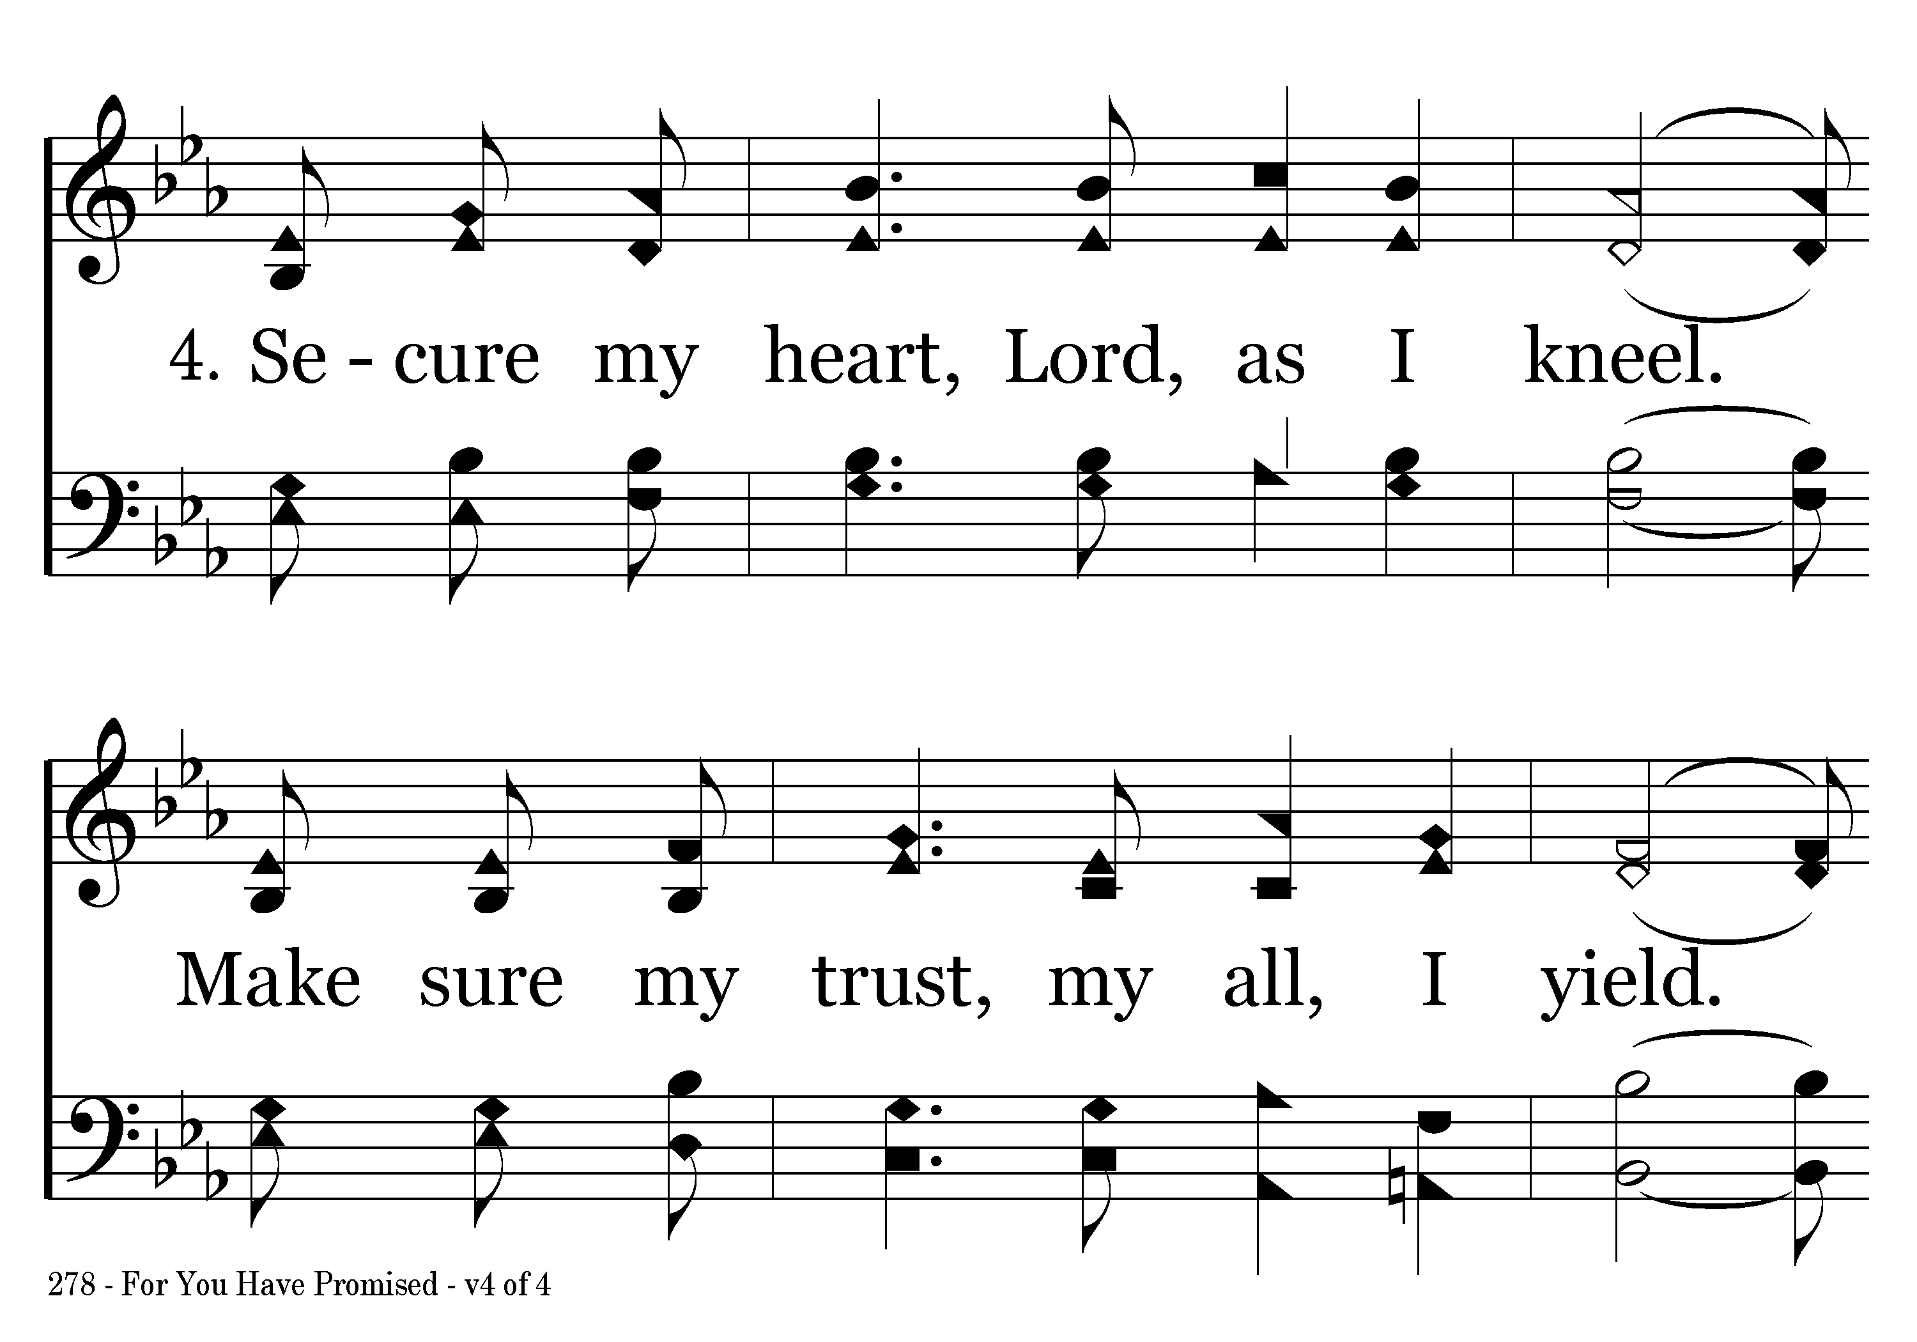
278 - For You Have Promised - 4.1

Slide 24
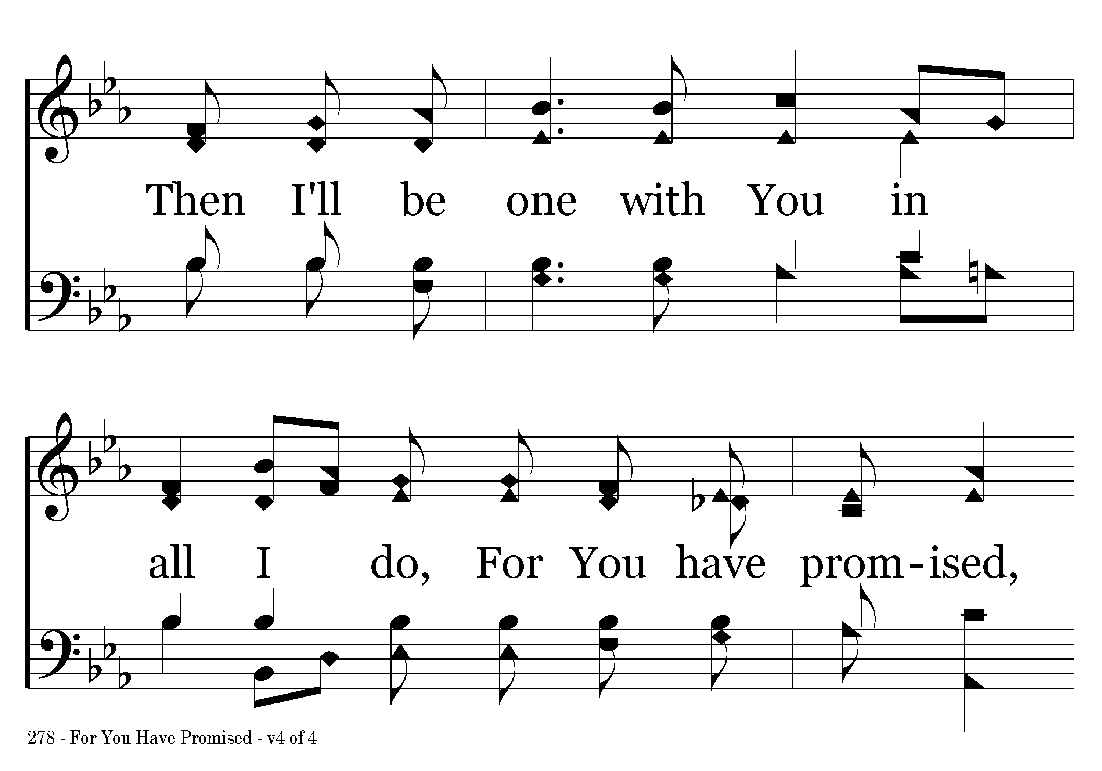
278 - For You Have Promised - 4.2

Slide 25
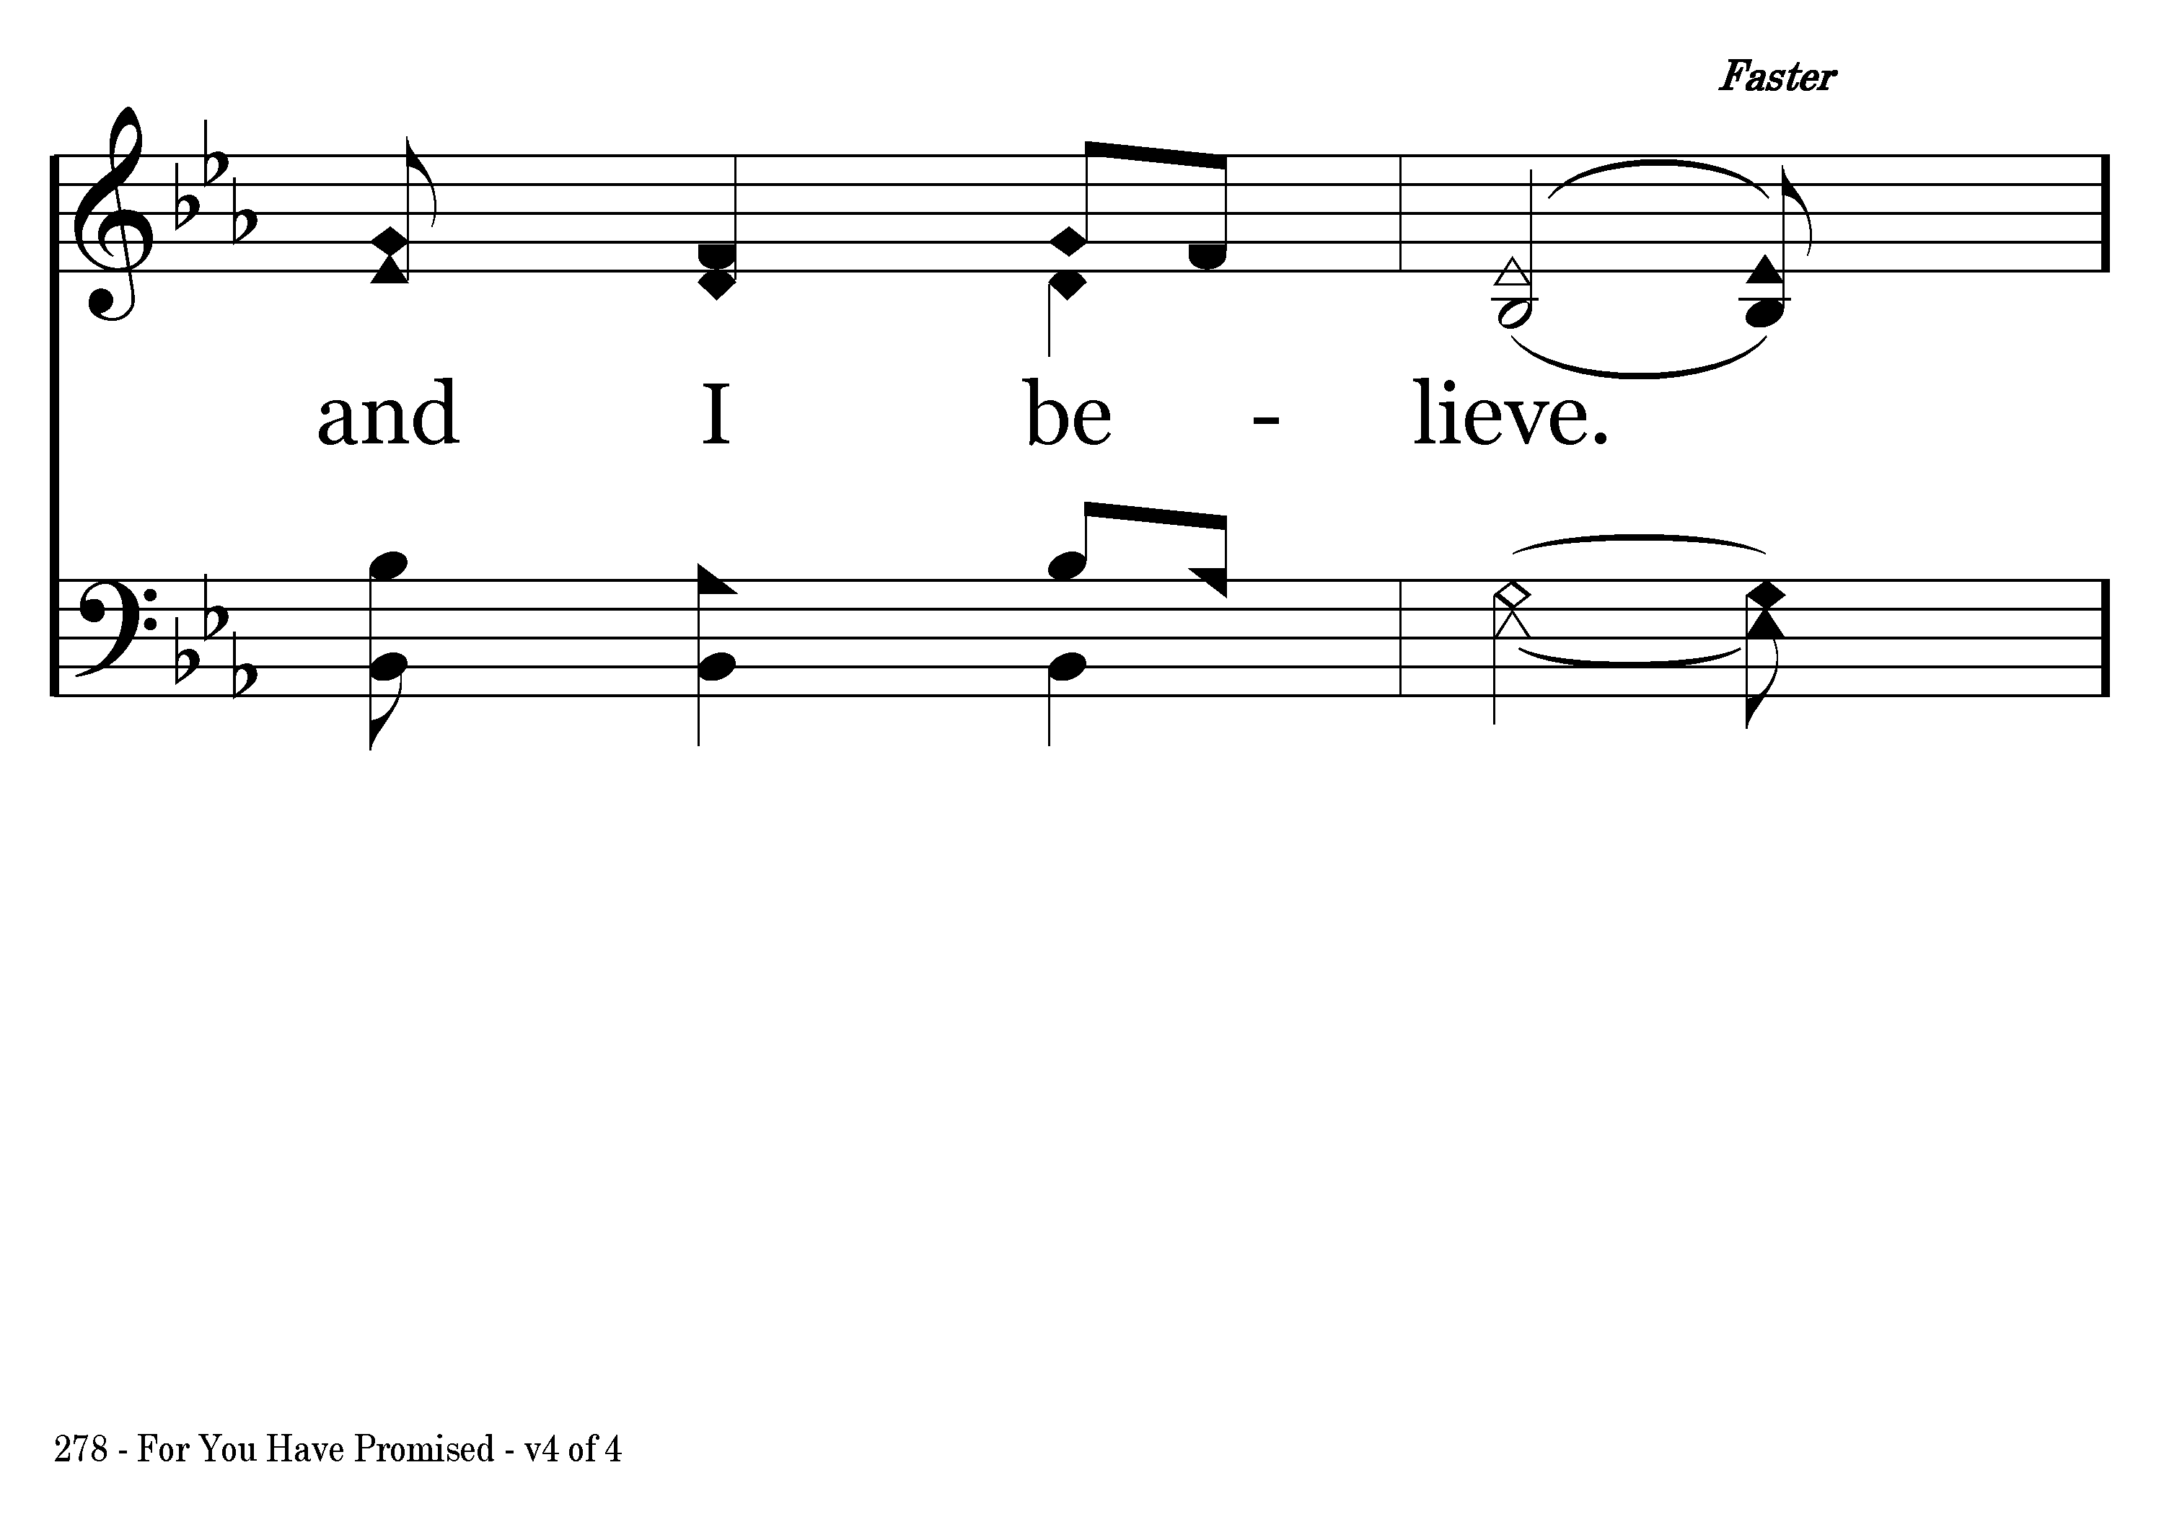
278 - For You Have Promised - 4.3

Slide 26
278 - For You Have Promised - C.1

Slide 27
278 - For You Have Promised - C.2

Slide 28
278 - For You Have Promised - C.3

Slide 29
278 - For You Have Promised - C.4
End of Song

